Slide 1


Big data at the individual level
PERSON NAME | Title here, BlueLabs
BlueLabs | Data, Analytics, Technology.
www.bluelabs.com

Slide 2




Who We Are
Lindsey Schuh Cortes
Elan Kriegel
Dan Porter
Chris Wegrzyn
Chief Operating Officer
President
Chief Analytics Officer
Chief Technology Officer
Lindsey joined the team after serving as Director of Strategic Partnerships for the Service Employees International Union (SEIU), and with a long history in organizing, she ensures BlueLabs is the most effective and results-driven organization to better serve our clients.
Elan has over 10 years of experience in tailoring high-quality, professional analytics programs designed to develop data-driven strategies for organizations across industries.
Dan is an industry recognized expert in the emerging field of persuasion (uplift) modeling, and was behind its very successful application in politics and for corporate needs over the past several cycles.
Chris began formulating a vision for the role of emerging data and analytics technology 7 years ago, and is currently considered one of the best practitioners in building tools to analyze, manipulate, and explore data technology across industries.
BlueLabs | Data, Analytics, Technology.
www.bluelabs.com

Slide 3

PAGE BREAK
This is what a page break should look like. The title is optional
BlueLabs | Data, Analytics, Technology.
www.bluelabs.com

Slide 4
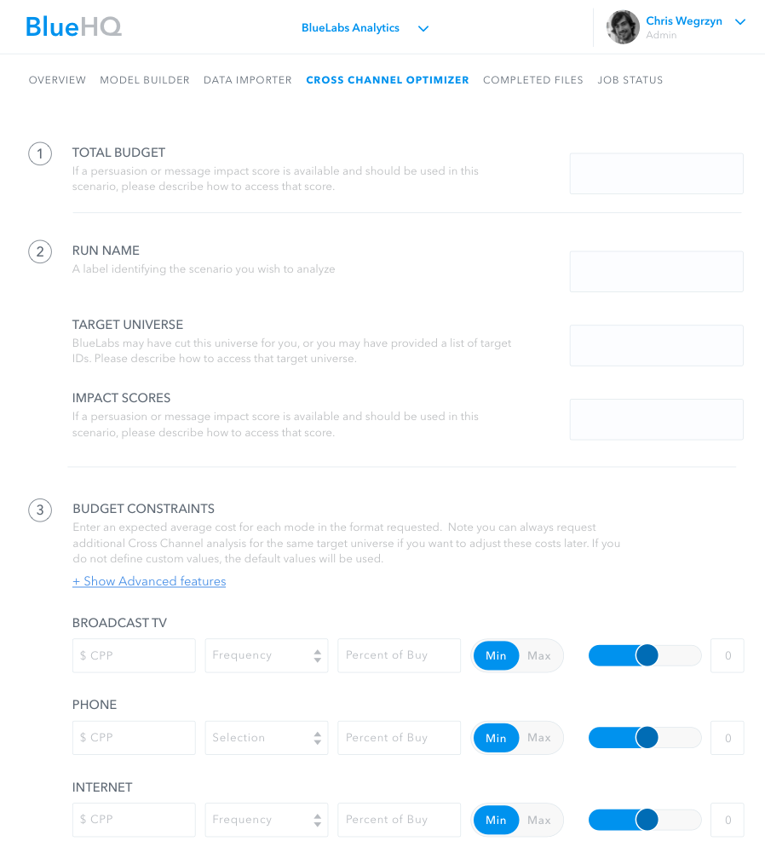
Text paragraph can go here. Option to add bullets as well.
Wow,
Everyone
Loves
Options!
Left aligned paragraph with Image
Image Example caption
BlueLabs | Data, Analytics, Technology.
www.bluelabs.com

Slide 5



Multiple items layout
www.bluelabs.com
Tailor messages to small audiences or even individuals
Identify the best channel to reach each person
Shape strategy and identify challenges and solutions
BlueLabs | Data, Analytics, Technology.
www.bluelabs.com

Slide 6
A table, neat.
 | Politics | Healthcare | Education | Marketing
Population | Voters | Hospital Patients | Students | Customers
Outcome | Vote for desired candidate | Don’t return to ER | Graduation | Buy Product
Treatment | Campaign outreach | Preventative Care | Extra support | Marketing Message
BlueLabs | Data, Analytics, Technology.
www.bluelabs.com

Slide 7

We’d Love to hear from you!
Person 1
Title
contact@bluelabs.com
(123) 456-7890
BlueLabs | Data, Analytics, Technology.
www.bluelabs.com

